Slide 1

Lower Gwynedd Comprehensive Plan ___________
Planning Commission
March 18, 2026
Claire Warner, Principal Community Planner I, MCPC

Slide 2
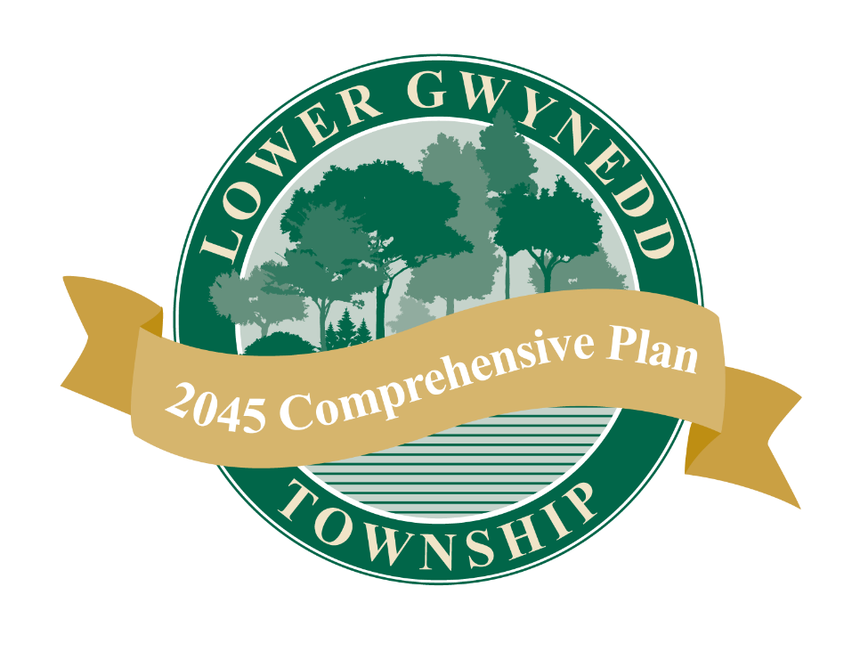
Agenda
Overview of the comprehensive plan contents
How was the public involved?
Key issues and recommendations

Slide 3
What is a Comprehensive Plan?
Long-range planning document providing a future growth and development guide
Identifies a community vision that guides the plan’s recommendations
Recommendations and implementation strategies are proposed to work towards that vision
Required by the Municipalities Planning Code (MPC) to be reviewed every 10 years
Geographically comprehensive
Comprehensive in subject matter
Long-range time frame
Bethlehem Pike Focus Area Recommendations

Slide 4
What topics are covered?
Demographic Trends (current and forecasted population, age distribution, educational attainment)
Current Land Use* (current land use, recent development trends)
Economy & Employment (unemployment, average commute, employment sectors)
Homes & Housing* (housing density, affordable housing)
Infrastructure* (water/sewer, energy)
Transportation* (traffic volume, bus and rail service, walkability)
Natural Resources* & Open Space, Recreation (wetlands, tree canopy, stormwater management, parks)
Cultural Resources* (historic districts, arts and culture)
Community Facilities* & Health, Safety (schools, libraries, emergency services, senior services, food access)
*Elements required by the Municipalities Planning Code

Slide 5
Comprehensive Planning Process
Kickoff
Public Engagement Part 1 –Issue Identification
Topic area Analysis
Bethlehem Pike Focus Area
Public Engagement Part 2 – Draft Recommendations
Review Final Plan
Adoption
Topic area Analysis

Slide 6
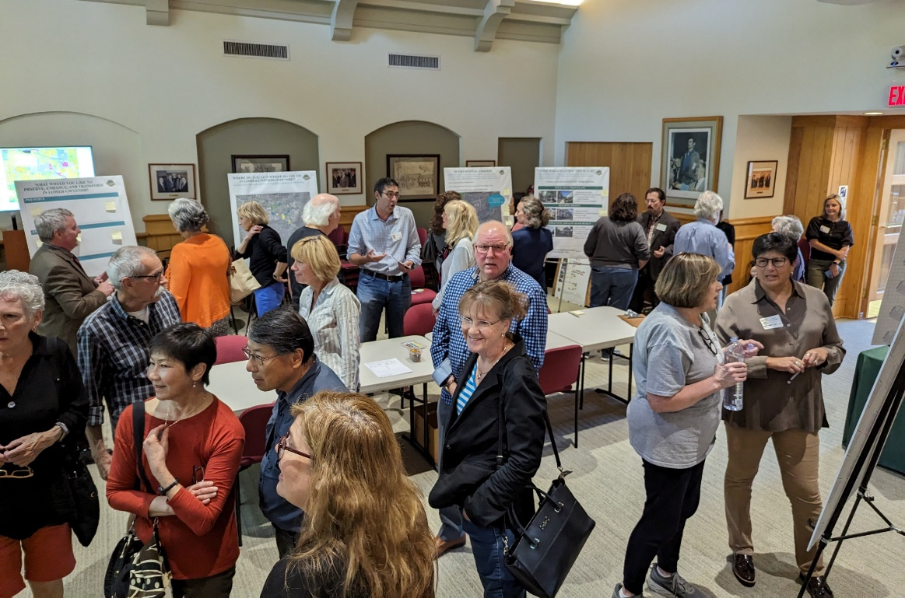
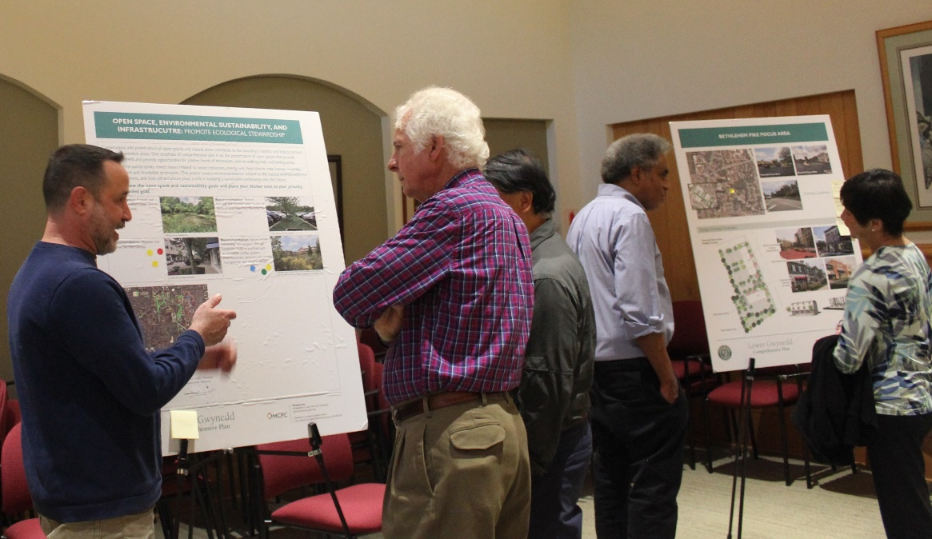
Public Engagement
Attended Fall Fest 2023
Community survey – Summer-Fall 2023 (533 responses)
1st Open House – October 2023
Draft Vision Statement Survey – Summer 2024 (87 responses)
2nd Open House – October 2024
Draft goals and recommendations survey – October 2024 (24 responses)
Ongoing social media and newsletter posts, page on the township website for people to see updates

Slide 7
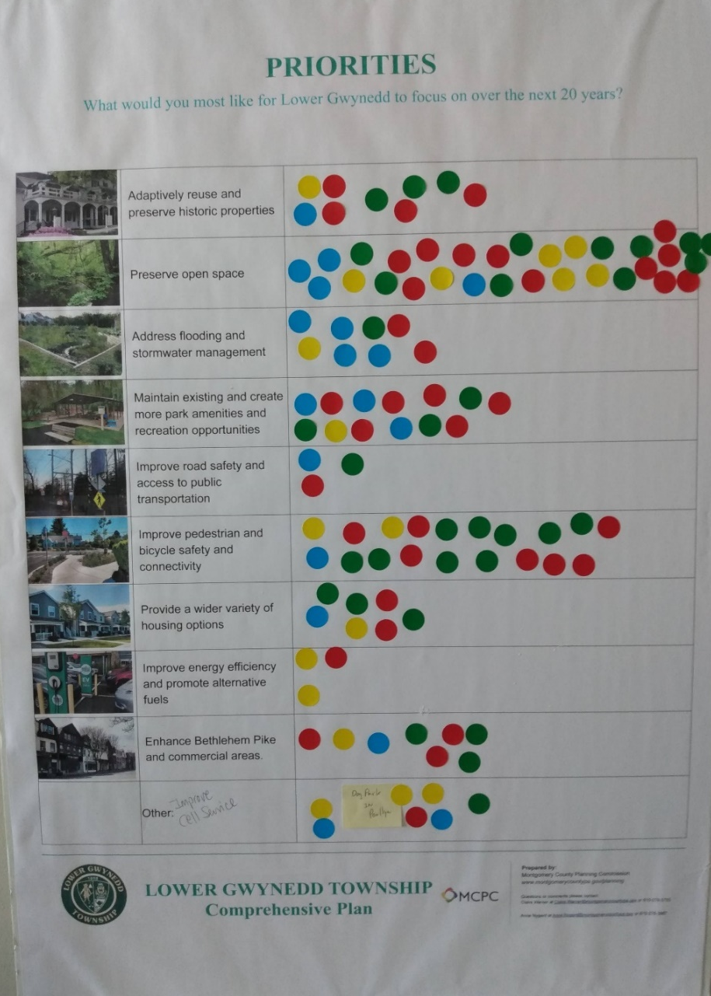
Public Engagement Feedback (1 of 2)
Community Survey and Open House #1
Issue identification
94% of respondents are residents of Lower Gwynedd, 5% are business owners, 4.5% are people who work in the township
Priority issues identified:
Maintain parts and recreation, open space (49%)
Redevelop underutilized commercial properties (41%)
Improve road safety and traffic issues (33%)
Preserve historic properties (26%)
Beautify existing commercial areas (25%)
Preserving open space, improving walkability, and creating a more welcoming experience on Bethlehem Pike were identified as key topics for further exploration

Slide 8
Public Engagement Feedback (2 of 2)
Open House #2 and Draft Vision and Recommendation Surveys
Key Takeaways from each of the topics:
Future land use and Vision. The majority of 85% of responses agree/strongly agree with the draft vision statement. Important topics: walkability, environmental stewardship, opportunities for small-scale retail and commercial, sustainable growth.
Community Institutions. Institutions are valued, especially the school district. Desire for more community space and businesses that could serve as "third places”
Housing. Balance between creating opportunities for growth in specific areas, and the desire to maintain the scale and character of established neighborhoods.
Transportation. Priority: build sidewalks and trails to improve pedestrian connections to destinations. Also, create safer streets and slow vehicle speeds through neighborhoods.
Open Space and Environmental Sustainability. Priority: improve and preserve the tree canopy. Also, preserve open spaces and natural resources, reduce waste, reduce flooding and improve water quality.
Notes:
Future land use and Vision – The majority of 85% of responses agree/strongly agree with the draft vision statement. Topics of importance are: walkability, revitalization of Bethlehem Pike, environmental stewardship, creating opportunities for small-scale retail and commercial, sustainable growth
Community Institutions – institutions are valued, especially the school district, but respondents expressed a desire for some community space and businesses that could serve as "third places” (social sustainability)
Housing - Equally strong feelings about creating opportunities for growth in specific areas, and the desire to maintain the scale and character of established neighborhoods. Mixed feelings about other housing types (missing middle, ADUs); also an interest in seeing more housing for an aging population
Transportation. Priority: building sidewalks and trails to improve pedestrian connections to destinations. Also creating safer streets and slowing vehicle speeds through neighborhoods., ensuring safe and convenient bicycle routes, and encouraging the use of public transportation.
Open Space and Environmental Sustainability - top issue to improving and preserving the tree canopy, followed by preserving open spaces/natural resources, reducing waste and energy consumption through sustainable practices, and reducing flooding and improving water quality. (more emphasis on open space preservation than parks, because of the recently completed park plan)

Slide 9
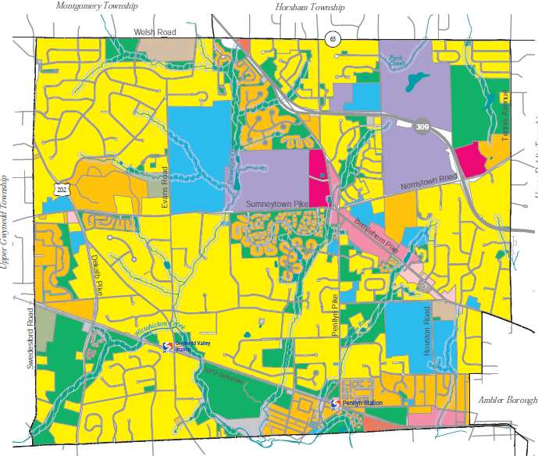
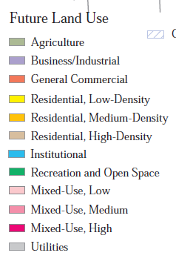

Future Land Use Map
Future Land Use Categories

Slide 10
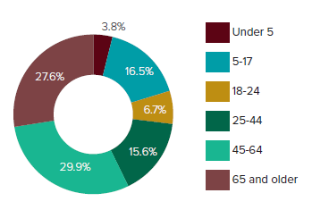
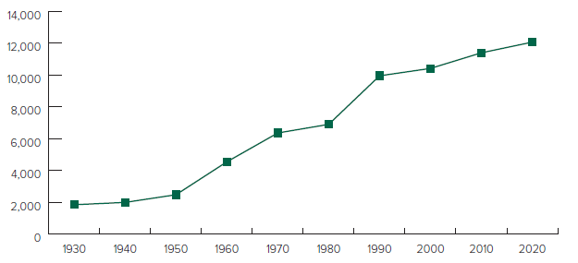
Place and People Context for future planning
Age Group Proportions, 2020
Takeaways
50% single-family residential
Population in 2020: 12,076
Population density: 2.03 persons/acre
Population growth since 2000: 16%
Median age: 49.8 (Montco median age: 41.2)
Total Population, 1930-2020

Slide 11
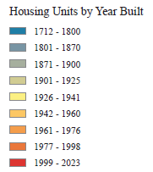
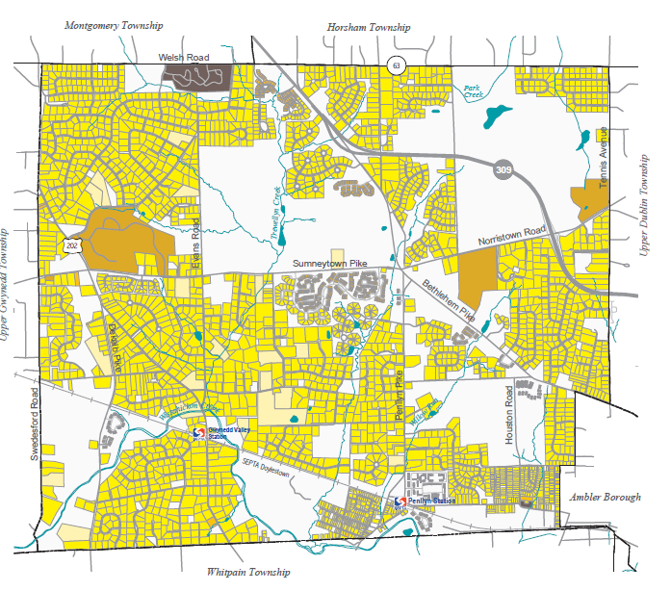
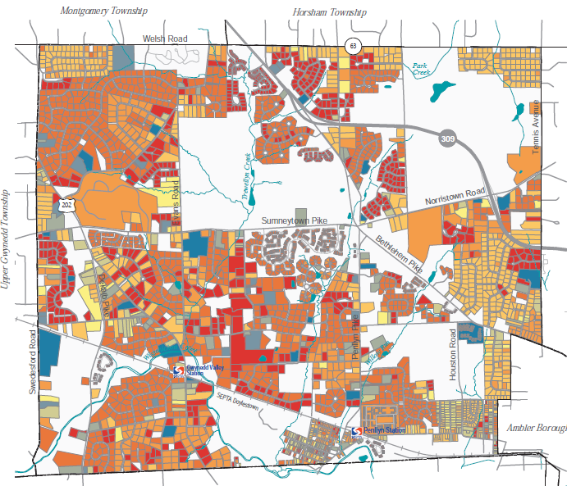
Housing and Neighborhoods Create livable communities
Housing Unit Type
Year Built, Residential Structures
Notes:
Takeaways:
Predominant housing type: single-family detached
Median household size in 2020: 2.45
Households with at least one person over the age of 65 years: 60%
More than half of housing units are valued over $500,000

Slide 12
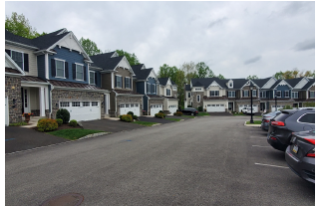
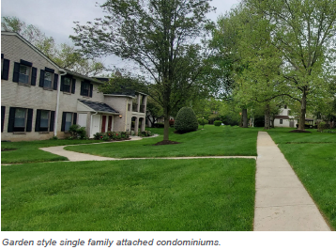
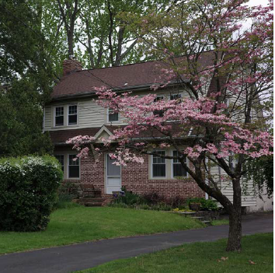
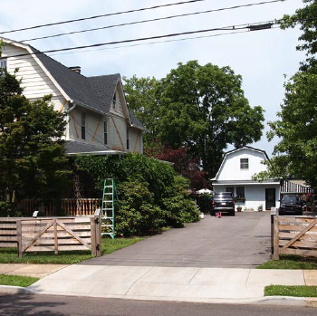
Housing and Neighborhoods Create livable communities
Goals and Recommendations
Goal: Maintain the overall scale and character of the township’s established residential neighborhoods.
Encourage the preservation of existing housing stock.
Goal: Meet the housing needs of current and future residents.
Allow a variety of housing types and densities.
Expand the housing opportunities in appropriate areas.

Slide 13
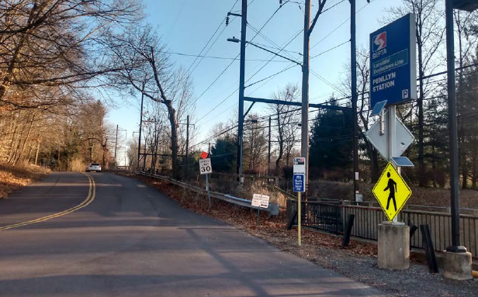
Transportation Provide for safe mobility and connections
Goals and Recommendations
Takeaways
Goal: Improve road safety and slow vehicle travel speeds through residential neighborhoods.
Identify common high-speed streets and install traffic calming strategies
Goal: Ensure safe and accessible pedestrian and bicyclist connections between the township’s residential areas and priority walkability areas.
Continue to pursue opportunities to expand and improve the sidewalk network.
Ensure safe and convenient bicycling routes to destinations
Goal: Encourage the use of public transportation.
Install pedestrian connections with wayfinding signage to train stations.
Encourage bus stop improvements during land developments
Most people (68%) drive alone to work
In 2022, 20% of people worked from home; 2% of people took transit to work
Crashes occur and people are concerned about road safety
Walkability (and bikeability) is important
Notes:
Takeaways:
Most people (68%) drive alone to work
In 2022, 20% of people worked from home; 2% of people took transit to work
Crashes occur and people are concerned about road safety
Walkability (and bikeability) is important

Slide 14
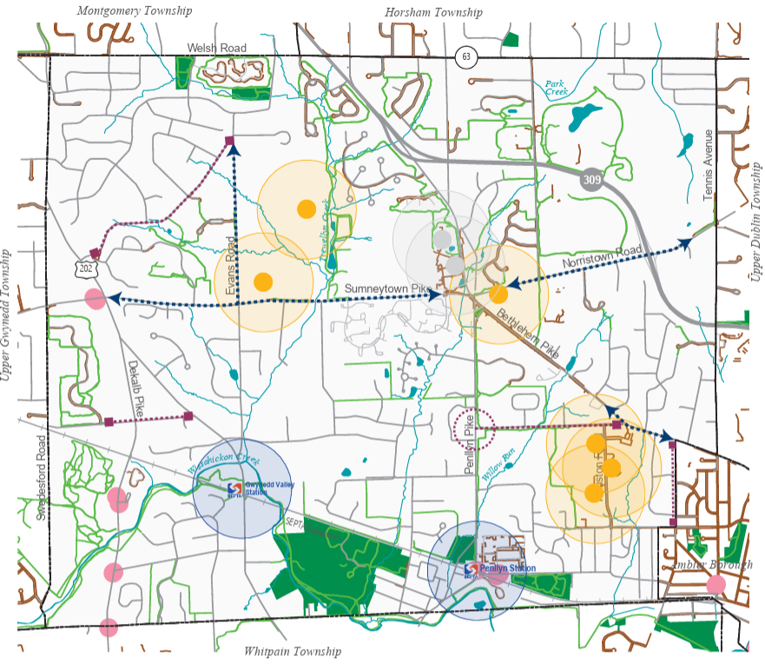
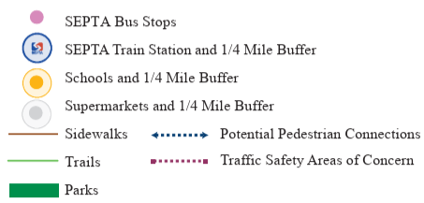
Transportation Priority Topic: Walkability
“Better pedestrian connections between Gwynedd Mercy and the Shopping Center”
“It might be useful to look at the value of sidewalks in areas around elementary and middle schools and other community focuses.”
“Length of Meetinghouse Road... is a common walking route for residents. No sidewalk or shoulder, and speeds are high/narrow road.”
“Create more walking and biking paths especially on the major roads, like Bethlehem Pike. Easier access to crossing that street would be great.”
Walkability Analysis

Slide 15
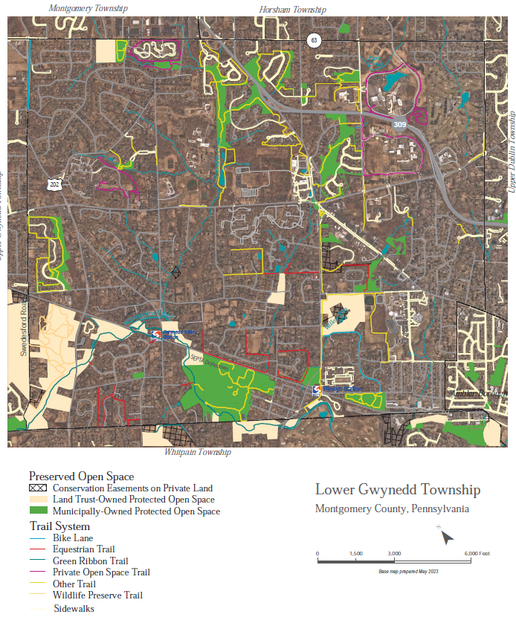
Open Space, Trails, and Parks Protect Community Assets
Takeaways
Nearly 750 acres of protected open space
Over 20 miles of walking trails
Completed Parks & Recreation Strategic Plan
Priorities: open space acquisition, trail construction
Goals and Recommendations
Goal: Protect and preserve the township’s remaining open space areas.
Explore opportunities for open space acquisition, including historic properties, greenway corridors.
Goal: Expand and improve upon the township’s trail network.
Prioritize gaps to fill to complete connections.
Consider creating an official map showing the township’s planned locations of future trail connections.
Goal: Enhance the township’s parks, recreation opportunities, open space, and natural resources.
Install sidewalks, trails, and bike facilities to improve access to parks and open spaces.
Notes:
Takeaway:
Nearly 750 acres of protected open space
Over 20 miles of walking trails
Completed Parks & Recreation Strategic Plan
Priorities: open space acquisition, construction of trails to bridge network gaps

Slide 16
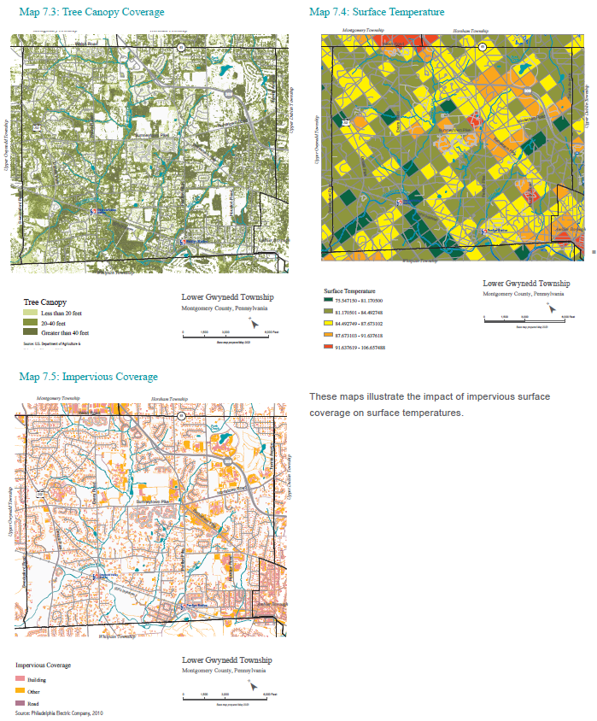
Environmental Sustainability and Infrastructure Promote Ecological Stewardship
Goals and Recommendations
Goal: Protect and preserve the township’s natural resources, including streams, wetlands, floodplains, riparian corridors, and woodlands.
Goal: Preserve and enhance the tree canopy for improved air quality and ecological benefits.
Identify areas where trees are in poor health, need to be replaced, or where there is a need for new trees.
Goal: Improve water quality of waterways that flow into the Wissahickon Creek.
Continue multi-municipal coordination to with the “Wissahickon Creek Water Quality Improvement Plan”
Goal: Reduce the impacts of flooding in flood-prone areas.
Goal: Reduce energy consumption and overall production of solid waste.
Tree canopy coverage and impervious coverage impact surface temperatures (heat island effect).

Slide 17
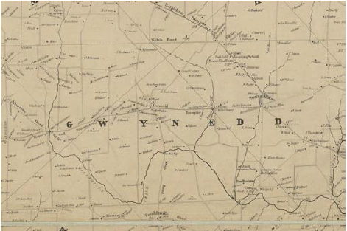
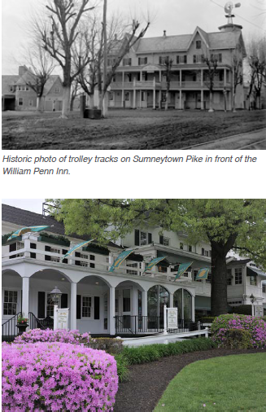
Historical and Cultural Resources Preserve significant places
Takeaways
Goals and Recommendations
Residents expressed a desire to preserve the historic buildings that are significant to the character and identity of Lower Gwynedd.
Preservation through adaptive reuse of the building is a sustainable practice.
Preservation can be incentivized through zoning.
Goal: Preserve locally significant cultural and historic resources, including structures and sites.
Complete an inventory of locally significant historic resources.
Review the zoning and update, as needed, to ensure sufficient incentivizes for the preservation and reuse of historic structures.

Slide 18
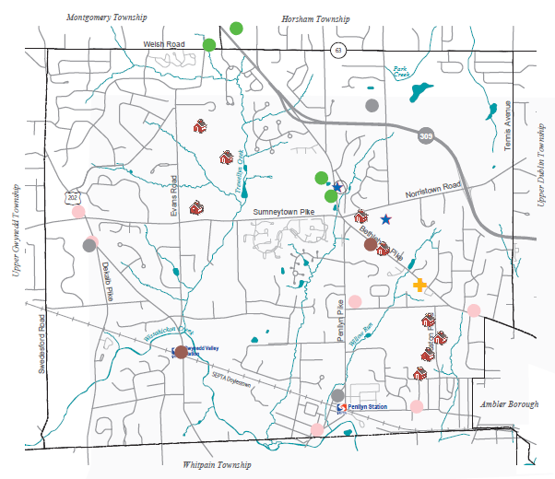
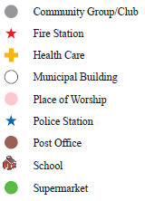
Community Facilities and Institutions Support community health
Takeaways:
Community facilities and institutions provide essential social, spiritual, and educational opportunities.
Good planning influences physical, mental, and social health.
Goals and Recommendations:
Goal: Support the township’s diverse cultural and institutional facilities.
Coordinate with the township’s institutional landowners to understand and plan for their long-term facility needs.
Goal: Improve health outcomes for the community.
Encourage healthy and active lifestyles with improved walking and biking infrastructure.
Create opportunities for social interaction with more public gathering spaces.
Goal: Continue to provide high-quality and efficient community services to township residents.

Slide 19
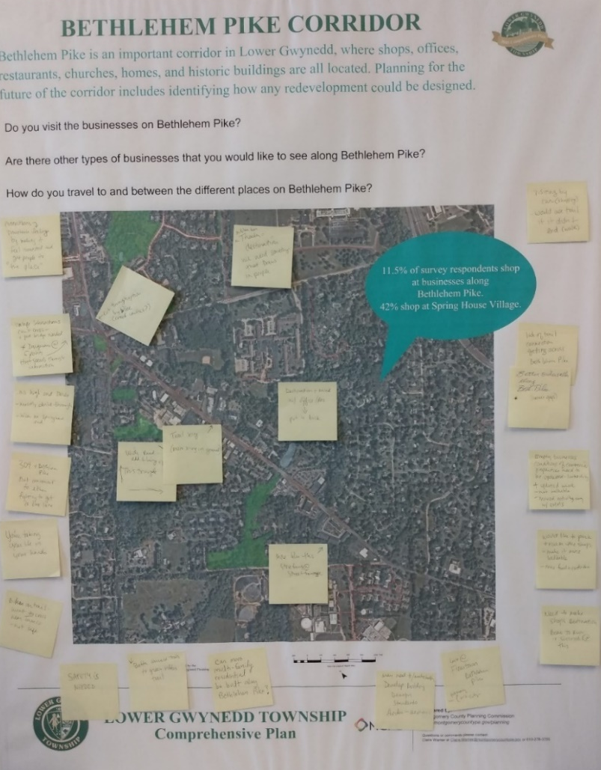
Bethlehem Pike Focus Area
Steering Committee Priorities + Public Feedback on Design Concepts
Active store fronts
Parking behind buildings, structured parking to reduce impervious coverage
Street trees, wider sidewalks
Areas that could be used for township events
Improved streetscape to create a safer and more pleasant walking experience
Improved pedestrian and vehicular connections
Preservation of natural features
More and better access to trails
Green space, gathering space
Goals and Recommendations:
Goal: Encourage redevelopment of underutilized or vacant properties to create an inviting streetscape.
Create building and streetscape design guidelines for new development and redevelopment.
Goal: Create a safe and comfortable Bethlehem Pike for all people.
Consider roadway improvements that would add greenery and slow traffic.
Consider safety improvements and potential locations for signalized Encourage healthy and active lifestyles with improved walking and biking infrastructure.
Create opportunities for social interaction with more public gathering spaces.
Goal: Continue to provide high-quality and efficient community services to township residents.

Slide 20
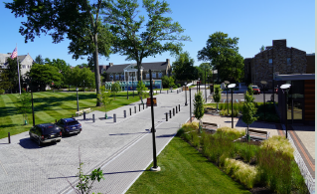
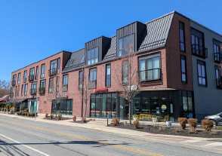
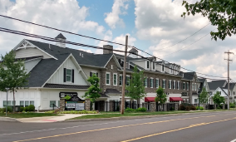
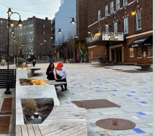
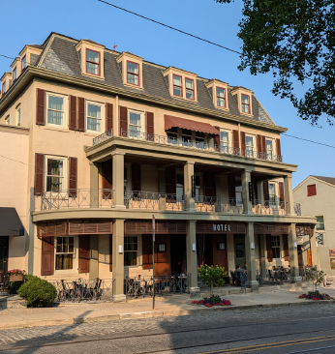
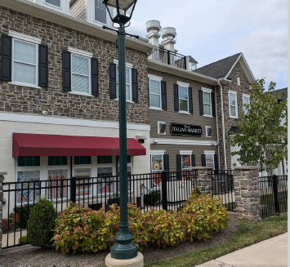
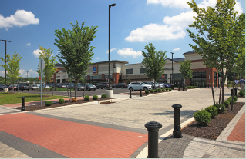
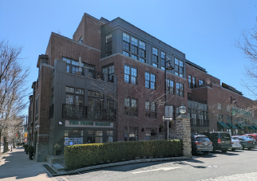
Bethlehem Pike Focus Area Design Concepts
Streetscapes, Plazas, and Shared Streets
Building Height and Architectural Features

Slide 21
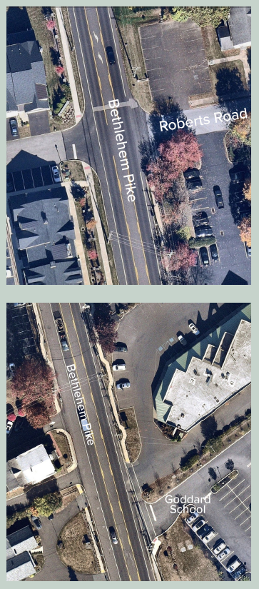
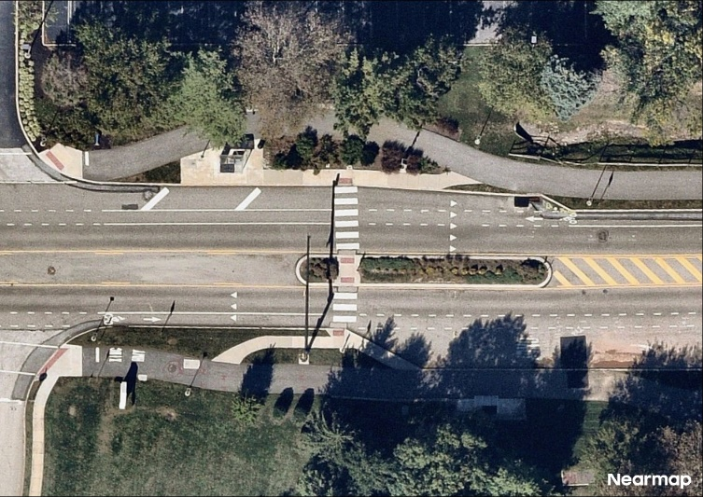
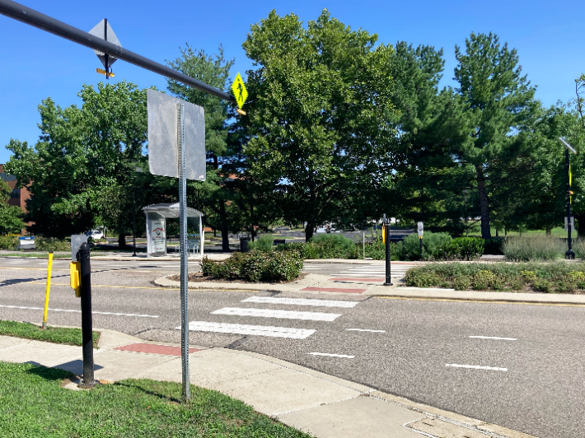
Bethlehem Pike Focus Area Safety Improvements
Support for improved streetscape to create a safer and more pleasant walking experience
Street trees, wider sidewalks
Signalized pedestrian crossings for better safety and connectivity
Potential Pedestrian Crossing Locations
Example of mid-block crossing and green median, King of Prussia

Slide 22
Thank you! Questions?
Claire Warner, Principal Community Planner I
clairewarner@montgomerycountypa.gov

